Slide 1
Chapter 3 The Relational Data Model and Relational Database Constraints

Slide 2
Relational Model
In relational model, the data and relationships are represented by collection of inter-related tables.
Each table is a group of column and rows, where column represents attribute of an entity and rows represents records.
Relation: A relation in relational data model represents the respective attributes and the correlation among them.
Attribute: any relation has definite properties that are called as attribute.
Tuples: Rows of table represents the tuple which contains the data record.
Domain: Domain is a set of values which is indivisible. For example date of birth must be greater than zero and can not be negative. This is called domain of an attribute.

Slide 3
Properties of relations
Each table in a database has unique identity(name).
Each row is unique.
Each attribute has a unique name.
Any entry at the connection of each row and column has a single value.

Slide 4
Relational Constraints
These are the restrictions or set of rules imposed on the database contents.
It validates the quality of the database.
It validates the various operations like data insertion, updating, and other processes that have to be performed without affecting the integrity of the data.
There are mainly 4 kinds of relational constraints:
Domain constraints
Key constraints
Entity integrity constraints
Referential integrity constraints

Slide 5
Domain Constraints
Domain Constraints: every domain must contain atomic values which means composite and multi-valued attributes are mot allowed.
We perform a datatype check to a column we can limit the values that it can contain. For example: if we assign the datatype of attribute age as int. we can not give its value other than int data type.

Slide 6
Key Constraints
These are called uniqueness constraints since it ensures that every tuples in the relation should be unique.
We choose primary key from candidate key to identify uniquely, we can choose any candidate key but should be least number of attributes.
Null values and duplicate keys are not allowed in primary key.

Slide 7
Entity Integrity Constraints
Entity integrity constraints say that no primary key can take a NULL value.
Referential integrity Constraints:
It is specified between two relations or tables and used to main the consistency among the tuples in two relations.
This constraints is enforced through a foreign key.
( Check Foreign key example )

Slide 8
Relational database schemas
A relational database schema helps to organize and understand the structure of a database, this is particularly useful when designing a new database, modifying an existing database to support more functionality, or building integration between databases.
Customer(cust_id, name, city )
Loan (loan_id, amount )
Borrower(cust_id, loan_id, access_date, borrow_id )

Slide 9
Relational database schemas
Loan Id
Amount
Name
City
Cust_id
Borror_id
Cust_id
Access date
Loan Id

Slide 10
Basic Relational Algebra
A relational algebra is a collection of formal operations acting on relations and producing relations as result.
It is one of the procedural query language in which a user requests information from a database.
The main operations of the relational algebra are the set operations (such as union, intersection and Cartesian product), selection (keeping only some lines of a table) and the projection (keeping only some columns).

Slide 11
Operations in Relational Algebra
Fundamental operations:
Select operation
Project operation
Union operation
Set difference operation
Cartesian product operation
Rename operation
2. Additional operations:
Set-intersection operation
Natural-join operation
Division operation
Assignment operation
3. Extended Relational Algebra Operations
Generalized projection
Aggregate functions
Outer join
Null values

Slide 12
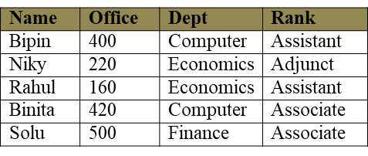
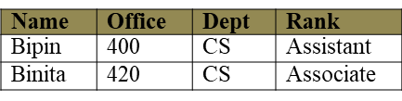
Relational Algebra Operations
Select Operation (σ)
This is used to fetch rows(tuples) from table(relation) which satisfies a given condition.
σDept = 'Computer' (Employee)
σdept = ‘computer' ˄ Rank = ‘assistant’ (Employee) ???

Slide 13
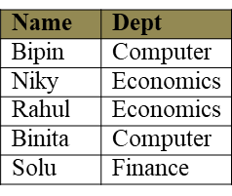
Relational Algebra Operations
Project Operation (∏)
Projection operation is used to extracts specified columns of a relation. With the help of this operation, any number of columns can be omitted from a table or columns of table can rearrange.
Syntax: - π<attribute-list> (Relation).
π name, dept (Employee)

Slide 14
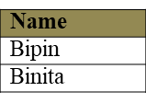
Relational Algebra Operations
Combining Selection and Projection Operations:
πname (σDept = 'Computer' (Employee) )
Union Operation ( ∪ ):
Consider the following relations R and S. The union of relations R and S is denoted by R U S and it is the set of tuples that are either in R or in S or in both

Slide 15
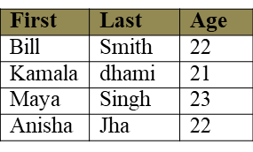
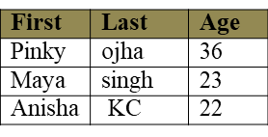
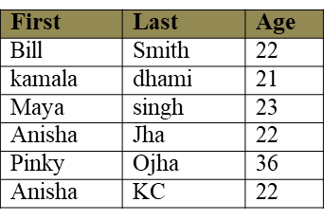
Relational Algebra Operations
R
S
R U S

Slide 16
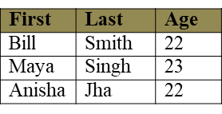
Relational Algebra Operations
Set Difference Operation (-):
Set difference is denoted by the minus sign (-).
It finds tuples that are in one relation, but not in another.
R - S

Slide 17
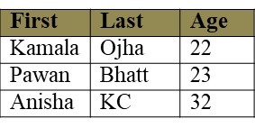
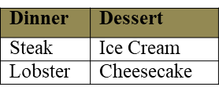
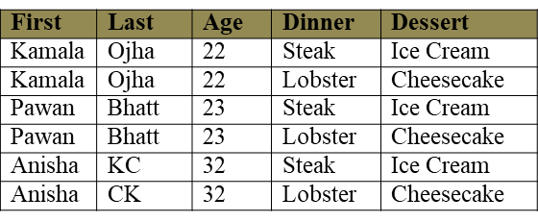
Relational Algebra Operations
Cartesian product(X):
The Cartesian product operation does not require relations to union-compatible i.e. the involved relations may have different schemas.
Cartesian product of two relations R and S is denoted by R X S.
R S
R X S

Slide 18
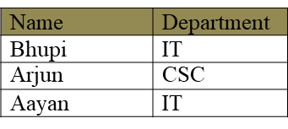
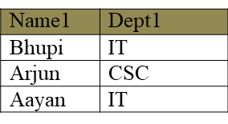
Relational Algebra Operations
Rename Operation:
The rename operator is denoted by rho ( ρ ).
Employee
^{𝝆}𝐸𝑚𝑝(𝑁𝑎𝑚𝑒1,𝐷𝑒𝑝𝑡1)^{(𝐸𝑚𝑝𝑙𝑜𝑦𝑒𝑒)}
^{Emp}

Slide 19


2. Additional operations
Set Intersection Operation ( ∩ ):
Set intersection is denoted by symbol ∩ and it returns a relation
that contains tuples that are in both of its argument relations.
Result: Relation with tuples that appear in both R and S.
R ∩ S
2. Join operations:
Natural Join( )
Theta Join( )
Outer join
Left outer join ( )
Right outer join ( )
Full outer join ( )

Slide 20
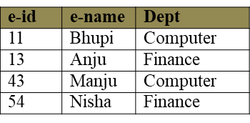
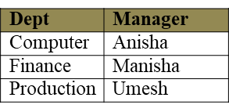
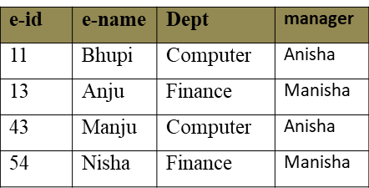
Additional operations
Natural Join/Inner Join: Natural join (⋈) is a binary operator that is written as (R ⋈ S) where R and S are relations.
Employee Department
Employee Department

Slide 21
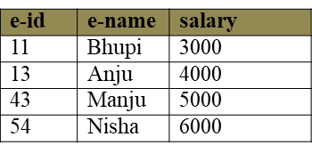
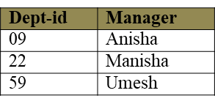
join operations
Theta join operation:
The theta join operation is an extension to the natural join operation that allows us to specify the join condition.
The theta condition consists one of the comparison operators
{=, <, <=, >, >=, < >}.
Employee Department
Then Employee e-id>Dept-id Department is

Slide 22
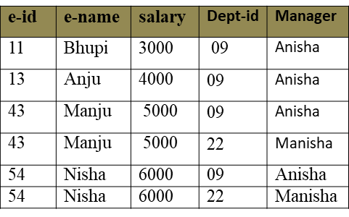
join operations

Slide 23
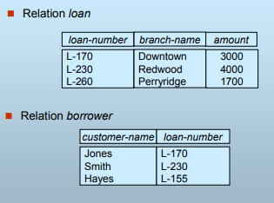
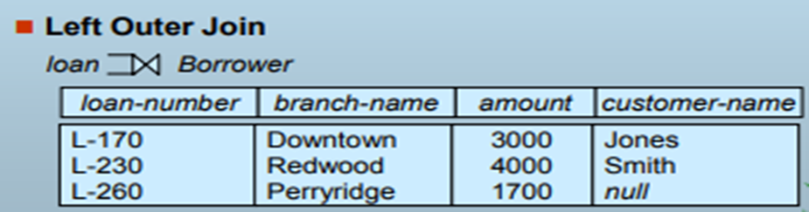
join operations

Slide 24

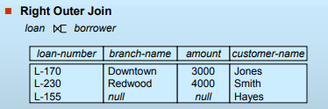
Join Operation
Right outer join (⟖): The right outer join of relations R and S is written as R ⟖ S,

Slide 25

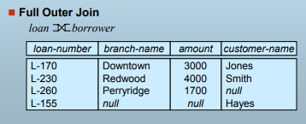
Join Operation
Full outer join (⟗): combined effect of left and right outer join, written as R ⟗ S where R and S are relations

Slide 26
Insertion operation
To insert data into a relation, we specify a tuple to be inserted.
Syntax: R←R U E
Where R is a relation and E is a relational algebra expression.
Example: suppose we have a relation employee
Employee (Name, Salary, Address)
Suppose we wish to insert an employee “Bhupi” of salary 50,000 and live in Kathmandu then we write
Employee←Employee U {“Bhupi”, 50000, Kathmandu}

Slide 27
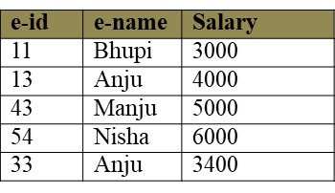
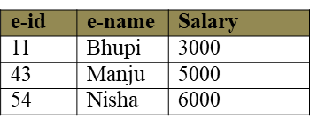
Deletion operation
We can remove the selected tuples from the database.
We cannot delete values of only particular attributes.
Syntax: R←R-E
Where R is a relation and E is a relational algebra expression.
Example: Delete all of Anju information from Employee relation
Employee
Employee ← Employee - σ e-name=”Anju” (Employee)

Slide 28
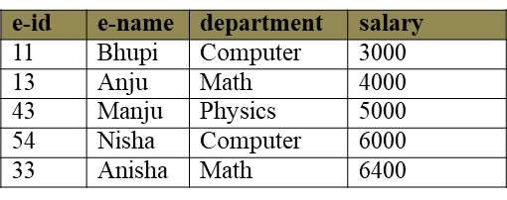
Updating Operation
In some situation we may wish to change a value in tuple without changing all values in the tuple. We can use the generalized-projection operator to do this task.
Syntax: ∏ <A1, A2,…..An> (Relation)
Where {A1, A2,........,An} are attributes.
Example: All employees working in department “Computer” has increased their salary by 15%.
Employee

Slide 29
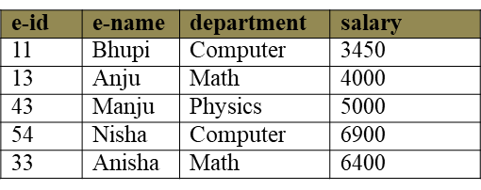
Updating Operation
Employee←(∏e-id, e-name, department, salary + salary*0.15 (σ department=”Computer” (Employee)) U ∏ e-id, e-name, department, salary (σdepartment ≠”Computer” (Employee)))

Slide 30
Assignments 3
Consider the relational database:
employee (person-name, street, city)
works (person-name, company-name, salary)
company (company-name, city)
manages (person-name, manager-name)
Give an expression in relational algebra for each of following requests:
Find the name of all employees who works for “NIBL Bank “
Find the names and cities of residence of all employees who work for “NIBL Bank”.
Find the names, street address, and cities of residence of all employees who works for “Software Company” and earn more than 50000 per month.

Slide 31
Assignments 3
Find the name of all employees in the database who do not work for “SBI Bank”.
Give all employees of “SBI Bank” a 15% salary rise.
Delete all tuples in the employee relation where employee’s city is “Kathmandu”.

Slide 32
Assignments 2
Describe database design process.
What are the uses of database abstraction in database design. Explain in your own words.
Describe the type of database language.
Why data models are needed in database design? Describe different types of database design model.
Explain database structure.
Define ER-Diagram. Draw the ER-Diagram of hospital library management system.

